Slide 1

STRAVA FITNESS DATA ANALYTICS CASE-STUDY

Slide 2
Case Study: How Can a Wellness Technology Company Play It Smart?
Background
Bellabeat, a high-tech manufacturer of health-focused products for women founded in 2013.
Bellabeat is a successful small company, but they have the potential to become a larger player in the global smart device market.
Urška Sršen, co-founder and Chief Creative Officer of Bellabeat, believes that analyzing smart device fitness data could help unlock new growth opportunities for the company.
Sršen knows that an analysis of Bellabeat’s available consumer data would reveal more opportunities for growth
We are asked to focus on one of Bellabeat’s products and analyze smart device data to gain insight into how consumers are using their smart devices

Slide 3
Business Task
The objective of this project is to analyze user activity, sleep patterns, and body metrics from smart fitness devices to understand user behavior.
Tools Used
Python – For exploring, processing and cleaning of data (some of the files contained rows more than Excel can handle
SQL – For more analysis and storage
PowerBI – Analysis and Visualization
Data & Source Integrity
Reliability
Data used for this project is from strava tracking device under brand Fitbit open/public data. The fitness data is from 33 individuals wearing strava fitness tracker. Since there is no information regarding participants’ age, sex and profession, accuracy and unbiased stand can not be vetted
Originality
Data set contains 33 user fitness tracking data down to the second. This data is collected between 12-4-2016 – 12-5-2016 which includes 19 days from April and 12 days from May. Totally 31 days of data is present

Slide 4
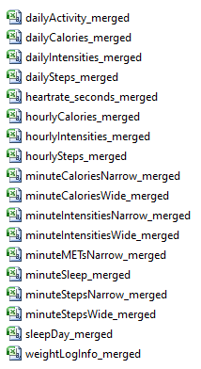
Comprehensiveness
There are some discrepancies in the data sets
There is no information about the age, sex, height and profession of the personnel providing fitness logs. This makes identifying pattern of activity of individual
dailyActivities_merged.csv contains distance data but there is no information regarding distance measuring unit but we are taking in km based on the steps taken
Not all participants have full 31 days of data. This makes the time-frame for data analysis inconsistent.
Some of the data contains 1440 mins of sedentary minutes which is equivalent to day. This indicates not wearing the tracker throughout the day
Data-set Observations
The Strava data set contains 18 files containing different tracking data. These are:
The data set has 18 files where 3 files are in both wide and long format
dailyActivity_merged file = dailyCalories_merged + dailySteps_merged + dailyIntensities_merged
In Remaining files the data is in minutes, hours and seconds, if we want to go into minute analysis we can use all those files.
In this Analysis , we are taking only the dailyActivity data (calories, steps, activity details, intensities), sleepday, weightlog data and heart_rate data
Heartrate_seconds_merged.csv contains heart rate of an individual for 24 hrs in seconds interval

Slide 5
Cleaning and Processing Data
Duplicates: No duplicates in all the datasets except daily_sleep which has 3 duplicates. Removed the duplicates
Null Values: We do not have null values in all the datasets except Weight_Info dataset has Fat column where 65 rows are null out of 67 rows present so we are ignoring the column
Data types: Changed the data type of Date column in all the 4 datasets to consistent format
New columns :
Added Month ,Week_name columns in all the 4 datasets
Added Sleep_hrs, Hours_in_bed columns in daily_sleep dataset
BMI_Category column in Weight_Info dataset in for better analysis
Analyzing the datasets
Daily_Activity there are 33 users with 940 rows
Daily_sleep we have 24 users with 410 rows
weight_info we have 8 users with 67 rows
Heart_ratesec there are 14 users with 2483658 rows.
So if we merge all the 3 files with common data we will loose lot of data. so trying to analyze them individually and then merging 2 individually

Slide 6
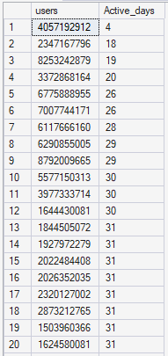



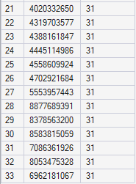
Analyzing dailyActivity data set
In the daily_Activity data 21 users are having 31 Active_days and the remaining 12 users have the Active days as shown in image on left
3 participants who are in April are not there in May
2347167796 -- Active for 18 days
4057192912 -- Active for 4 days
8253242879 -- Active for 19 days
Average calories burnt per month
Average Steps taken per month

Slide 7
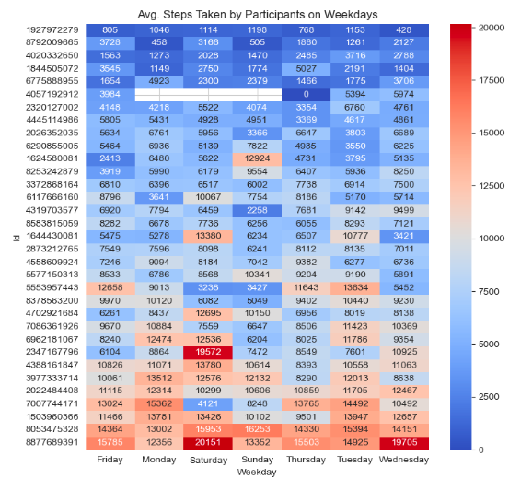
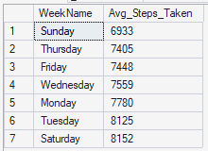
Analyzing daily_Activity Steps taken
Based on the data we can say that steps taken is higher on Tuesday and Saturday and lowest on Sunday
The users 8877689391 and 8053475328 are taking high steps taken weekly
1927972279 and 8792009665 has the lowest steps taken weekly

Slide 8
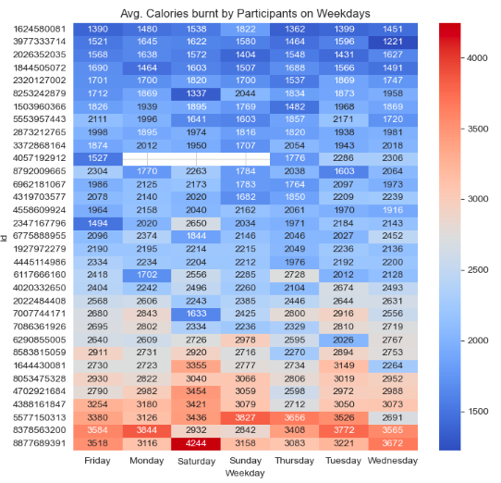
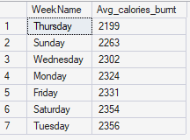
Analyzing daily_Activity Calories burnt
Based on the data we can say that calories burnt is higher on Tuesday and Saturday and lowest on Thursday
The users 8877689391 and 8378563200 are taking burnt high calories weekly
1624580081and 3977333714 has the lowest calories burnt weekly

Slide 9
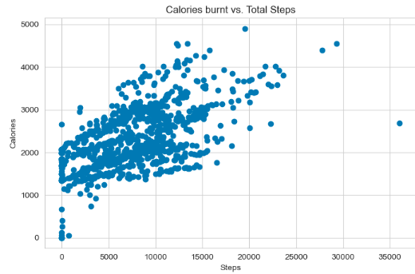
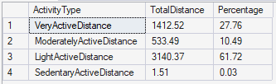
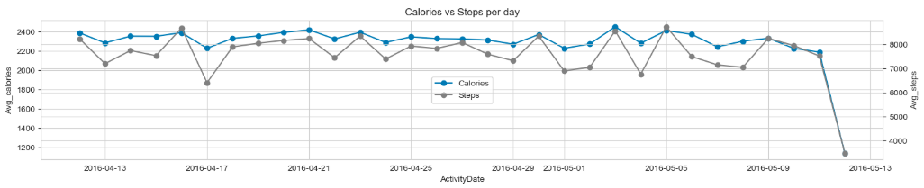
Steps taken vs. Calories burnt
We can say that total steps is directly proportional to calories burnt. As the no. of steps increases the Calories burnt increases

Slide 10
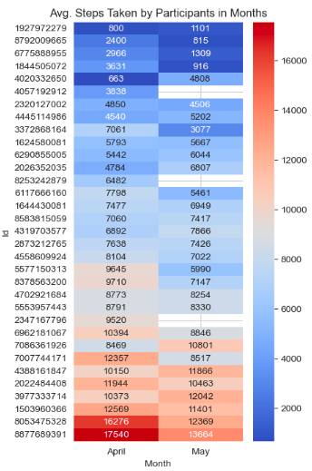
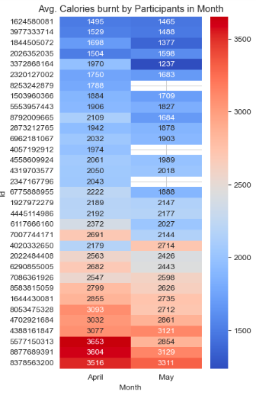
Analyzing daily_Activity Steps taken and calories burnt
Out of 33 we can see only 6 participants are taking the 10,000 steps/day. We can see those with 10,000 steps are not losing calories we should look into their food habits

Slide 11
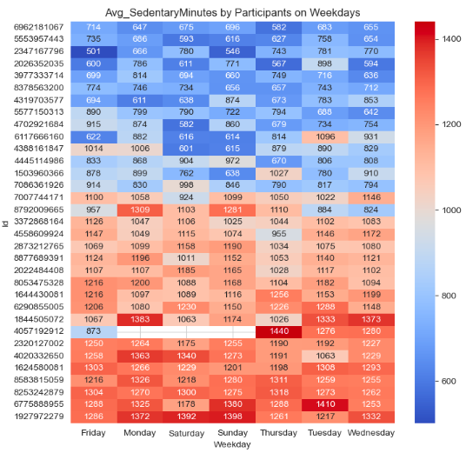
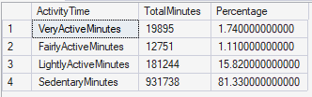
Active vs. Sedentary minutes
Any activity with very low movement or energy expenditure is called sedentary.
Sedentary minutes are recorded when : you are sitting, Lying down, Working at a desk, Watching TV, Driving
Sedentary time varies widely (500–1400 min/day) across participants.
Many participants consistently show >1000 sedentary minutes, indicating highly inactive lifestyles.
Participant behavior matters more than weekday differences, suggesting lifestyle-driven inactivity.

Slide 12
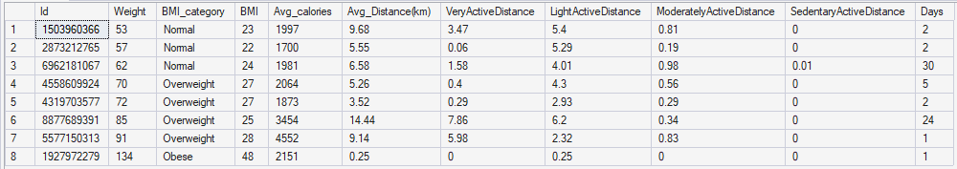
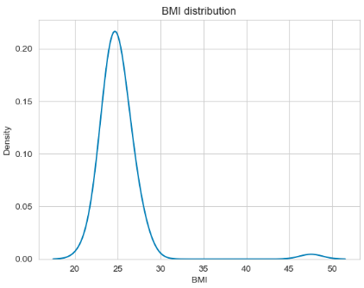
Analyzing weight & daily_Activity
We have weight info of 8 participants whose weight information is available.
We have very limited data of weight_info of participants. As we can see only 2 participants data is available for >20 days and rest of participants we have 1 or 2 days data
The BMI distribution is peaked because the data of participant who have 30 days data is peaked
We can say that obese person is having less activity

Slide 13
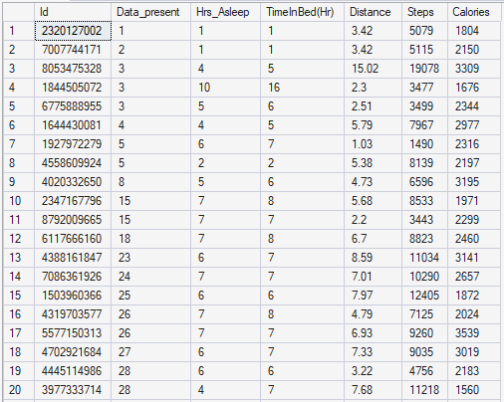
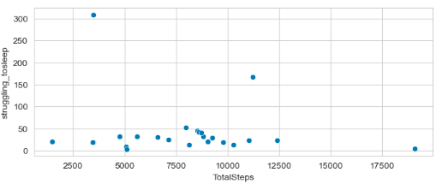

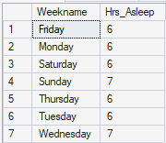

Analyzing sleep & dailyActivity
We can see two participants who are struggling to sleep as we can see the difference between TimeInBed and Hrs_Asleep > 3 rest are able to sleep within 1 hr of going to bed
We have 6 members who have <5hrs sleep

Slide 14
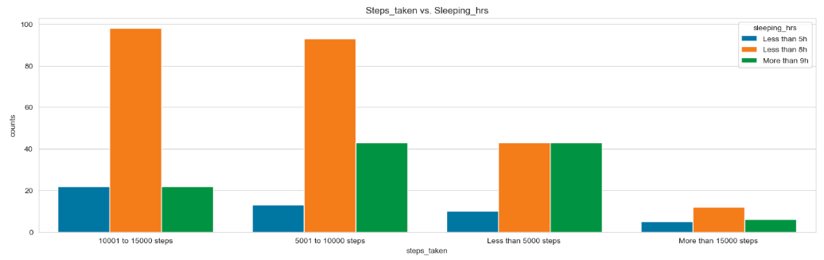
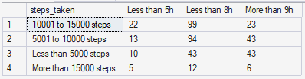
Sleeping_hrs vs. Steps_taken
Moderately Walking between 5000 to 15000 steps can help to have good sleep between 5 hrs to 9hrs
people walking more than 15000 steps are not having enough sleep

Slide 15
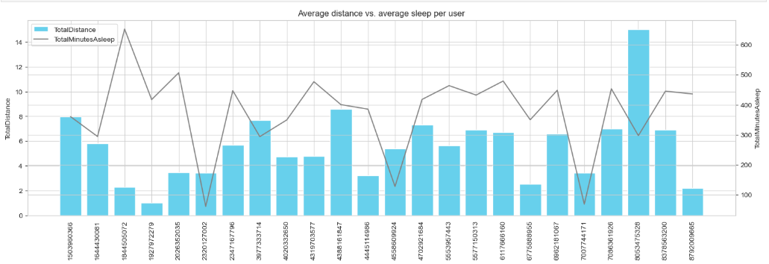
Distance vs. MinutesAsleep
We can't find any relation as there are respondents with good sleep without covering minimum distance and people covering greater distance who are not having good sleep

Slide 16
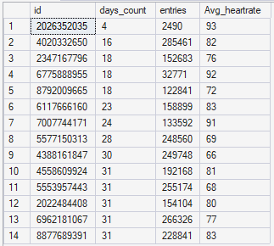
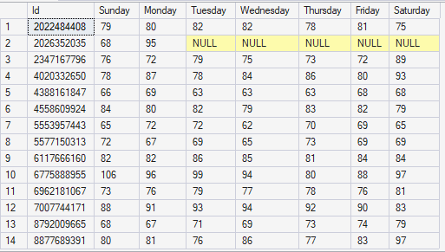

Heart_rate analysis
We have heart_rate of 31 days and of 14 participants and Avg_heart rate per user is between 66 and 93 which is normal.
We have heart_rate of 2026352035 for only 4 days and only on Sunday and Monday and he is having data for 2 days in April month and 2 days from May month

Slide 17
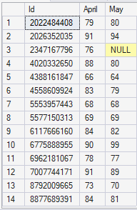
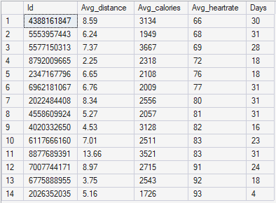
Heart_rate vs. dailyActivity
We have heart_rate of 2347167796 for only April month

Slide 18
Business Insights
Respondents are mostly using the device for tracking steps, heart-beat, sleep , weight info ,calories burnt
Many users do not reach recommended 10,000 steps/day only 6 participants out of 33
suggest customer to have regular activity of walking by giving personalized messages as they have forgot to walk on a particular day.
Customized messages of calories intake, calories burnt, weight info, sleep , heart-rate, steps taken on particular day.
Higher activity correlates with higher calorie burn
The participants who walk 10,000 steps but the calories burnt are less because of the calorie intake. suggest them on diet and calories to maintain healthy life style
Inform customers with unusual heart beat for check-up
Some users fall into overweight BMI category , give suggestion on food habits and activity best suited to reduce calories.
Some users do not meet sleep recommendations ,send customized messages of how get sleep better to participants who have sleep <5hrs and struggling to sleep
Users spend large time sedentary

